Slide 1
Energy Spectrum, Power Spectrum and Bandwidth
The energy of a signal x(t) , denoted as E, is defined as
The signal, x(t), is an energy signal if for that signal.
The power of a signal x(t), denoted as P, is defined as
The signal, x(t), is a power signal if for that signal.

Slide 2
Since
It follows that :
If the energy of the signal is finite, then the power in this signal is zero
If the power in the signal is non-zero, then the energy E is infinite.
In general, this implies that a signal with finite energy is bounded and of finite time duration eg pulses. They may be of infinite time duration but they tend to zero as time tends to infinity.
On the other hand, a signal with finite power tends to be of infinite duration, they do not tend to zero as time tends to infinity. Mathematically, a bounded signal that is a power signal must exists for an infinite interval of time.
A signal cannot be both an energy and power signal but it can be neither.

Slide 3
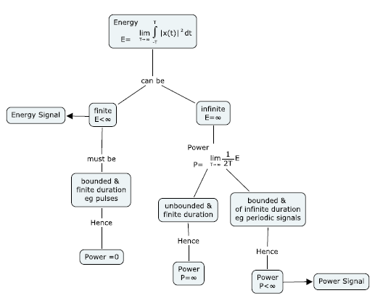
Mind-map of Energy & Power

Slide 4
Example 4-1 : Find the energy of the signal x(t) below.
A
0
→ t
From the definition of energy,
From the definition of power, it is obvious that P is zero for x(t).
Conclusion is that if the energy is finite, then the power is zero.
Hence a rectangular pulse is an energy signal.

Slide 5
Example 4-2 : Find the power of the signal x(t) below.
From the definition of power,
In this signal, the power is finite, the signal is bounded and extends over an infinite time and the energy is infinite. Hence a sinusoidal signal is a power signal.

Slide 6
Example 4-3 : What type of signal is a ramp signal, x_{R}(t)?
x_{R}(t)
1
t
Hence a ramp signal is neither an energy nor power signal; both are infinite.

Slide 7
Energy Spectral Density – frequency domain idea
Consider
Then the energy of x(t) can also be computed from its Fourier Transform via the following theorem :
The function is known as the energy spectral density of the signal x(t). Note that it is a function of frequency f and is always positive ie phase is always zero.
This formula is often known as the Rayleigh Energy Theorem.

Slide 8
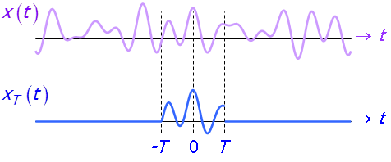
Power Spectral Density
Consider

Slide 9
Then the power of x_{T}(t) can also be computed from its Fourier Transform via the following theorem :
where
The function P_{x}(f) is known as the power spectral density of the signal x_{T}(t). Note that it is a function of frequency f and is always positive with phase of zero as well.
This formula is often known as the Parseval Power Theorem.

Slide 10
Energy and Power Spectral Densities of Periodic Signals
Consider a periodic signal, x_{p}(t), with period T_{p} given by :
A periodic signal is not an energy signal!

Slide 11
Computing the power, P,
In general, for a periodic signal, because
Hence a periodic signal is a power signal!
Furthermore, the power spectral density is given by

Slide 12
Summary of Energy and Power Spectral Densities
If signal, x(t), is an energy signal and is non-periodic, then the energy spectral density, E_{x}(f), is given by :
where X(f) is the FT of x(t). If x(t) is periodic, then it cannot be an energy signal.
If signal, x(t), is a power signal and is periodic, then the power spectral density, P_{x}(f), is given by :
where c_{k} is the Fourier coefficient of x(t). If x(t) is an energy signal and is non-periodic, then its power is zero.
Moral of the story is whether it is an energy or power signal, its energy or power spectral density is related to the Fourier transform coefficients.

Slide 13
Signal Bandwidth
Let
The bandwidth of a signal is a measure of the width of the frequency range over which S_{x}(f) > 0.
In the figure above, the bandwidth of the signal is Hz.
Unit of bandwidth is either Hertz or radians/s
There are different types of bandlimited signals.

Slide 14
Bandlimited or Band restricted Signals
Lowpass Signal x(t) :
Bandpass Signal x(t) :

Slide 15
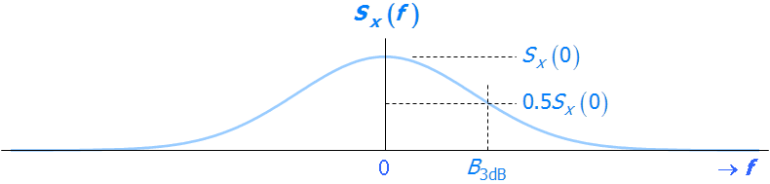
Signals with Unrestricted Bands
In general, practical signals are seldom strictly bandlimited, but have infinite frequency extent. For such signals, from the signal processing and system design standpoint, it is often useful to define a bandwidth measure to include only the significant frequency components of the signal.
3dB Bandwidth (B_{3dB}) – lowpass signal
The 3dB bandwidth is defined to be the frequency at which the spectral density drops to 50% or 0.5 of the spectral density component at zero frequency

Slide 16
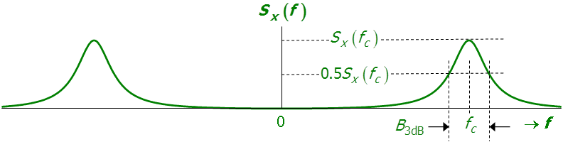
For a bandpass signal ie not lowpass
f_{c} is the centre frequency of the bandpass signal.

Slide 17
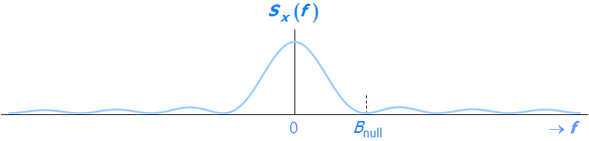
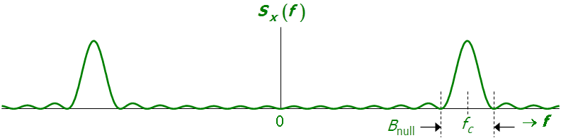
1st Null Bandwidth (B_{null}) – lowpass signal
Null means zero
For a bandpass signal ie not lowpass

Slide 18
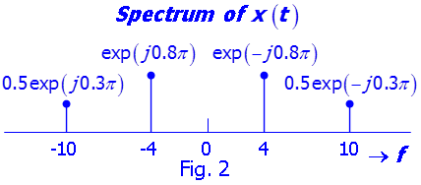
Self-Test Example 1
Sketch the amplitude and phase spectra of
Self-Test Example 2
The discrete-frequency spectrum of x(t) is given in Fig. 2.
Write a mathematical expression for x(t).
Let denote the Fourier series of x(t) , of
which f_{p} is the fundamental frequency. Evaluate c_{k}.

Slide 19
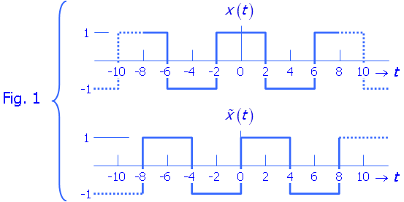
Self-Test Example 3
Two periodic signals, and are shown in Fig.1. Let
and be their respective complex exponential Fourier Series coefficients.
Find . Hence show that the Fourier Series expansion of comprises cosine components.
Using the results of part (a) or otherwise, show that the Fourier Series expansion of comprises only of sine components.
[Hint : ]

Slide 20
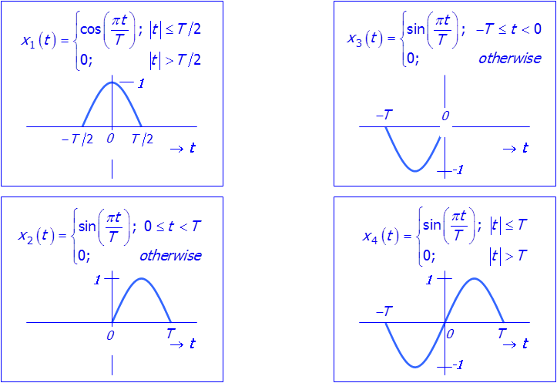
Self-Test Example 4
The waveforms of 4 pulses, x₁(t), x₂(t), x₃(t) and x₄(t) are shown in Fig. 3. Determine the spectrum X₁(f) of x₁(t) and express the spectra of x₂(t), x₃(t) and x₄(t) in terms of X₁(f).

Slide 21
Self-Test Example 5
The spectrum of a Gaussian pulse
has the form :
Where the parameter σ>0 is a measure of the time spread of x(t). Let B denote the 3-dB bandwidth of x(t). Compute the time-bandwidth product σB and comment on the result.

Slide 22
Self-Test Example 6
Determine whether each of the following signals is an energy signal,
a power signal or neither.

